Slide 1
New technics of selection, manipulation and placement of objects for editing in Virtual Reality
Dmytro Kadar Supervisor: Ing. Uršula Žákovská
Open Informatics - Computer Games and Graphics

Slide 2
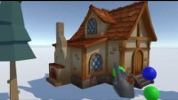
Inspiration

Slide 3
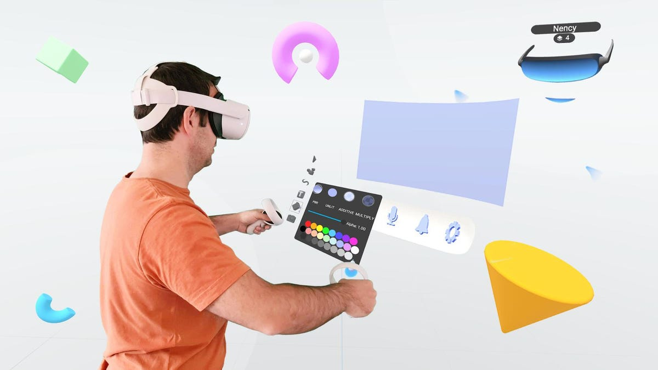
Analyse
ShapesXR – 3D models, sounds, scenes creation in VR
Object selection by drawing shapes:
Only concepts were found

Slide 4
Implementation
Standalone app for Oculus Quest
Developed in Unity and uses Unity XR Interaction Toolkit
PDollar for gesture recognition

Slide 5
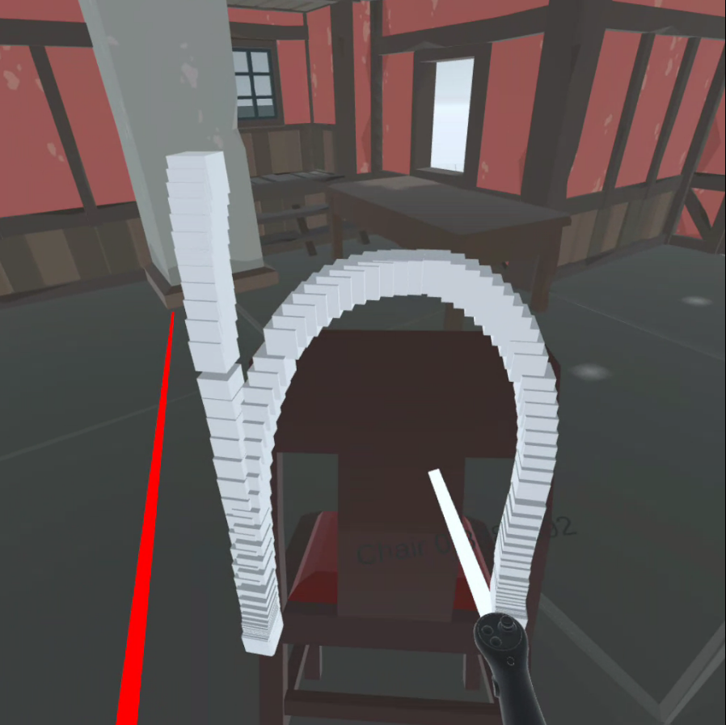
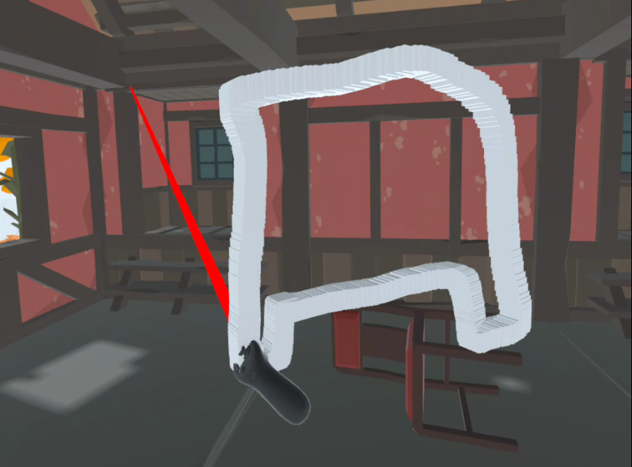

Slide 6
Testing
5 people
Testing was done individually
Composing scene in Unity, then in VR project

Slide 7
Testing Results
Scene creation in VR is better
Ordinary object selection is preferable
Different styles of handwriting are hard to recognise

Slide 8
Conclusion
Shape recognition is not very practical in game development
More suitable for games
Making scenes in VR is more intuitive

Slide 9
Future of the project
Adding more object manipulation features
New ways of object selection(voice recognition, selection from list)
Better save system and scene recreation in Unity

Slide 10
Thank you for attention

Slide 11
How would you use your implementation (one stroke drawing) to select a particle effect from the assets?

Slide 12
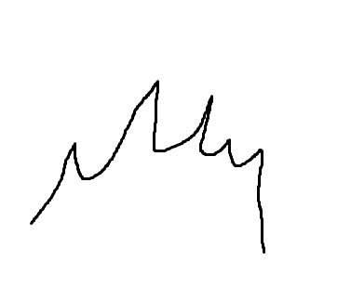
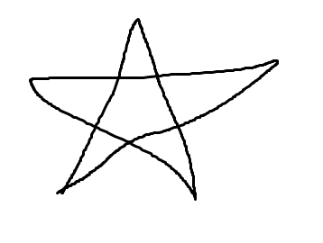
Recognisable by people shapes
Fire
Stars particle

Slide 13
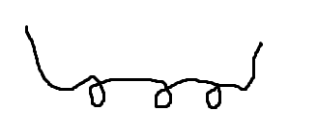
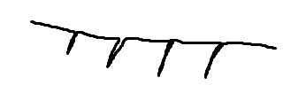

Particles, connected by line
Water drops
Line-shaped particles
Spiral-shaped particles

Slide 14
Links
https://youtu.be/50ohFOo1wzM https://imageio.forbes.com/specials-images/imageserve/618d340a310422cc6066afd9/Tavori-MR/960x0.jpg?format=jpg&width=960

